Slide 1
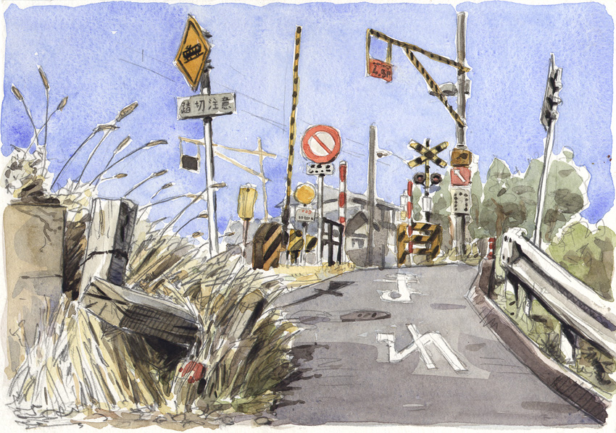
SURVIVING
YOUR FIRST
FEW MONTHS
IN NIIGATA
Brandon & Janice
August 10th, 2016

Slide 2
Active JET Community
Beaches
Mountains
Festivals
Life in Niigata can be great!

Slide 3
Hot Summers
Countryside placement
Lots of driving
First real job
No familiar support system
But it can also be tough.

Slide 4
OUR COMPANY
NIIGATA’S HOT SUMMER
And how to stay cool

Slide 5
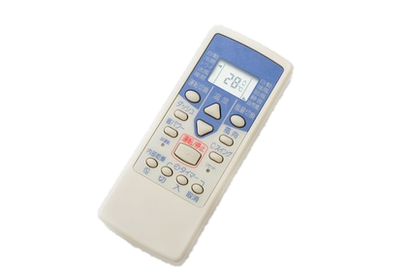
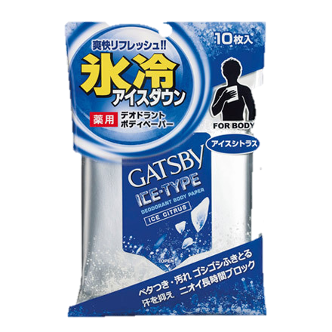
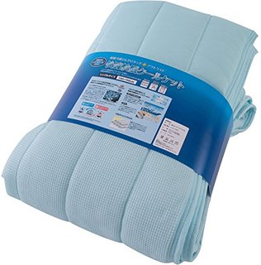
Tips to stay cool
¥3500
¥400
¥1000
SOFT COOL BLANKET
Magical temperature regulating blanket that
will help you sleep cool
GATSBY ICE WIPE
Contains menthol to instantly cool
down over heated bodies.
WATER COOL
TOWEL
Simply soak it in cold water, wring it
out, give a quick "snap," and it’s ready
to drape around your neck.
AC TIMER
Time your AC to turn on when
you arrive home from work.

Slide 6
Other summer problems
1
CULTURE SHOCK
2
BOREDOM
3
DRIVING
4
SIGNING UP FOR INTERNET
OR A CELL PHONE

Slide 7
CULTURE SHOCK
CULTURE
LIFESTYLE
BREAKING
CONTRACT
LANGUAGE
EXPECTATIONS

Slide 8
CULTURE SHOCK
The Solution
Limited and quickly forgotten
Don’t ask “why?”
Do not bottle it up
Talk to fellow:
JETs
Friends
Family back home
Stay active
Contact a PA (Brandon and/or Janice)
Remember that “your” Japan is not all of Japan.

Slide 9
BOREDOM
The Problem
Arrive during summer break and Obon season.
No classes
Little work
Few responsibilities
Feeling of uselessness
The Solution
Work will pick up
You’re the new guy
Familiarize yourself with your situation
Be proactive

Slide 10
DRIVING
THE PROBLEM
Having to drive immediately
THE SOLUTION
Drive safe, drive slow
Talk to your RA or older JETs for advice
Study the road signs (available at ajetniigata.com)
“Oh God I just got here why do I have to drive, why are the roads so narrow, why didn’t that person stop at the red light, so many gaijin traps, oh JEEZ, where did that old lady come from!?”

Slide 11
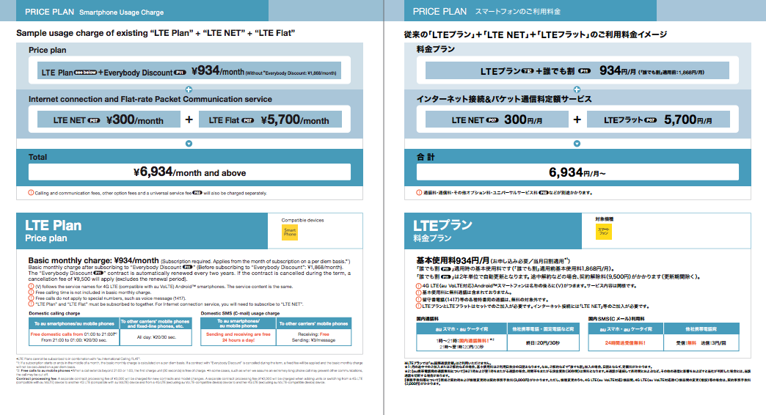
CELL PHONE
AU service provider:
Online English catalog
More cell phone information on the online ‘Welcome to Niigata Packet’

Slide 12
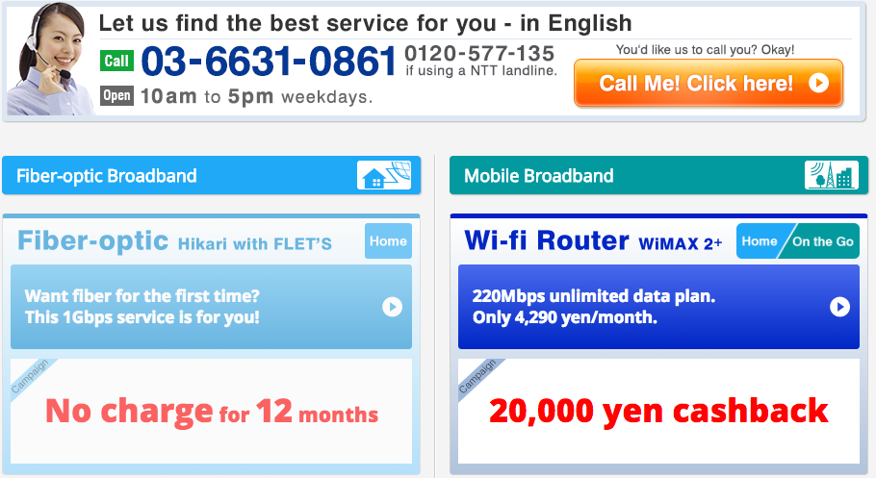
INTERNET: With English support
ASAHI-NET
English support
Phone
Email
Types of service
Fiber Optic
WiMax2+ (portable)
More internet information on the online ‘Welcome to Niigata Packet’

Slide 13
AUTUMN
Start to settle into life
Understand your work responsibilities
Find your group of friends
Travel around Niigata
Autumn problems:
Spreading yourself too thin
Communication issues

Slide 14
Spreading yourself too thin
The Problem:
Very easy to be very active
Parties, hobbies, sporting events, Japanese classes, travelling, judo, tea ceremony, English club, enkais, etc, etc, etc.
Can lead you to crash and burn later in the year
The Solution:
Think before you say yes
Live your life at 70-80% of your normal pace
Take time to recharge
Assess the things that you would be willing to drop

Slide 15
COMMUNICATION ISSUES
The Problem:
JTEs don’t tell you anything
People have unreasonable expectations
Stuck in your predecessor’s shadow
The Solution:
Teachers have their own work
New workers are often given very little training
Other teachers = afraid of speaking to you
E-mail your supervisor or other teachers
Ask questions
Discuss problems & expectations with teachers

Slide 16
Other Autumn tips
1
Finish setting up your apartment
Happy home, happy life
You will not finish setting up your apartment in winter
2
Get to know teachers at your school
3
Get close to people in your local community
4
Get involved with AJET events

Slide 17
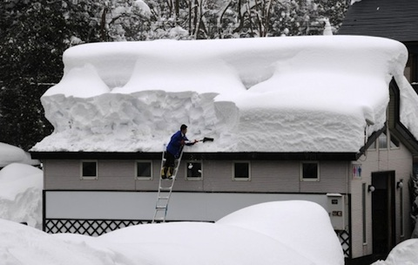
WINTER
Life in Japan becomes normal:
Every day is no longer an adventure
Get good at your job
Problems:
Culture fatigue
Conflict in the workplace
The snow

Slide 18
CULTURE FATIGUE
HONEYMOON STAGE
FATIGUED STAGE
ADJUSTED STAGE
FATIGUED STAGE

Slide 19
CULTURE FATIGUE
The Solution:
Keep a support group
People with a similar cultural background
Friends and family back home
Take a break
Pick your battles and learn to let things go
You do not have to adapt to Japan in every way
It is probably a temporary feeling
The Problem:
The little stresses of foreign life
Differences in expectations
Differences from home country
Emotionally draining
Stress of daily life
Loss of old identity
Small problems = huge hassles

Slide 20
CONFLICT IN THE WORK PLACE
The Problem:
Still feel like you’re treated poorly
Some teachers seem to dislike working with you
No communication, don’t feel trusted
The Solution:
Remember:
Different work cultures
Some people will just not like you
Some people are just “buttheads”
Are you overstepping your bounds?
You will not revolutionize English teaching in Japan
Japan = high context society
Address problems when they are small
Help your Japanese coworkers understand your feelings

Slide 21
SNOW AND THE COLD
THE PROBLEMS:
1
Niigata has the heaviest snowfall in Japan
2
Poorly insulated apartments
THE SOLUTIONS:
1
Take steps to winter-proof your apartment
READ the Online Welcome to Niigata Guide on how to do this.
Enjoy the snow!
2

Slide 22
OTHER WINTER TIPS/INFO
Stay Active
It’s very easy to hermit during the winter
Buy things online
Amazon
Rakuten
Are you re-contracting?
Deadline is in January
Many contracting organizations will want to know earlier

Slide 23
WHAT DOES YOUR SUPPORT SYSTEM LOOK LIKE?
JET PROGAM
PARTICIPANTS
Contracting
Organizations
Prefectural
Advisors
CLAIR

Slide 24
FIRST LEVEL: CONTRACTING ORGANIZATION
Contracting Organization
Management
Supervisor
Co-workers
First stop for school, work, and housing related information, issues, and questions.
Know your specific situation and contract.
Remember:
Maintain a good working relationship
Maintain communication and work together
If unable to build a good relationship with your supervisor…
Find another co-worker who can help
Your supervisor:
May be new
May make mistakes
May be busy
May also be useless/non-existent

Slide 25
FIRST LEVEL: CONTRACTING ORGANIZATION
As of July 2014, JETs are expected to go to their supervisor and CO first with questions and problems.
Talk to your CO before contacting a PA
Talk to your CO to contact CLAIR
Apply to your CO for Counseling Subsidy (50% or up to 20,000 yen)
CLAIR is working to strengthen training and support for COs

Slide 26
SECOND LEVEL: PREFECTURAL ADVISORS
3 PAs in Niigata Prefecture
CIR PA = Brandon Howard
ALT PA = Janice Laureano
Japanese PA (JPA) = Yasumasa Kondou
Important because:
Have access to lots of information and resources
Experience with Japanese offices
Can contact CLAIR
Required to maintain confidentiality
Remember:
May not necessarily agree with you

Slide 27
PREFECTURAL ADVISORS...
1
Act as a confidential consultants for JETs with serious issues
2
Distribute vital information via email (PLEASE CHECK YOUR EMAIL REGULARLY)
3
Work with relevant groups to hold annual work events (e.g. orientations)
4
Contact RAs to confirm safety of all JETS after a natural disaster

Slide 28
HOWEVER...
PAs do not know everything
We may make mistakes.
We’ll always try to help and be there for you, but being PA is in addition to our other work. We get busy too. Please be patient.
We are available during our regular work hours.
Please contact us outside of these work hours only for EMERGENCIES.
Please use e-mail to contact us. Phone is acceptable as well but is best scheduled ahead of time.
We do not hold any authority over you and are not your bosses.
No, we cannot get you:
A transfer
A raise
Your nenkyu information
A new apartment
The answer to the meaning of life

Slide 29
AND REMEMBER...
The following may and will usually have your answers!
General Information Handbook
The online Niigata Welcome Pack
Ajetniigata.com
Please read them thoroughly. It won’t make your vision any worse.

Slide 30
THIRD LEVEL: CLAIR
Council of Local Authorities for International Relations
Runs the JET Programme
Programme Coordinators (PCs)
Make the GIH and CO Manual
As of July 24th 2014, JETs are no longer able to contact CLAIR directly
Any inquiries should first be made to your CO, who will then contact the CLAIR Information Desk
PAs are also able to call the CLAIR Information Desk directly

Slide 31
ADDITIONAL LEVEL: REGIONAL ADVISORS
JET volunteers who help out others in their respective areas.
Important because:
Welcome new JETs and try to help them acclimate
May have experienced the exact same problems new JETs will
Answer questions and provide information about daily life in the region
Help JETs get the help they need when they cannot handle the issue personally
Contact JETs to confirm their safety after a natural disaster or other emergency event has taken place and report the results to the PAs
Remember:
The RA position is a volunteer position
Not for serious work or personal problems

Slide 32
ADDITIONAL SOURCES OF SUPPORT
Counseling provided by CLAIR
JET Mental Health Counseling Assistance Program
JET Online Counseling Service (Free)
Web mail
Skype
Other
Tokyo English Life Line (TELL)
03-5774-0992
9:00-11:00pm
Telljo.com

Slide 33
BREAKING CONTRACT
If you are considering breaking contract, PLEASE contact a PA
Situations can often be resolved with mediation
If you don’t tell us, we may not find out until too late
Breaking contract is often a huge financial burden
Think carefully about recontracting
Fairly common
On average, 2.09 % of all JETs
Niigata:
2015-2016: 2 JETs
2014-2015: 2 JETs
2013-2014: 3 JETs
2012-2013: 1 JET
Many reasons:
Employment, Education, or family matters: 50%
Personal Reasons: 50%

Slide 34
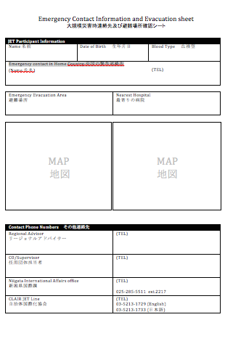
OTHER INFO
Disaster preparedness and evacuation areas
Will be discussed during this afternoon’s regional meeting.
Make sure you know who your RA is

Slide 35
THANK YOU
THANK YOU
QUESTIONS?

