Slide 1
A LADY’S GUIDE TO LIFE IN JAPAN
Presenters: Ashleigh Stebbins
& Anne Marie Hart

Slide 2
GIRL TALK!
Professionalism and Workplace Relationships
Relationships
Daily Life
Sexual Harassment

Slide 3
PROFESSIONALISM

Slide 4
APPEARANCE
Dress very professionally at first
Look at those around you - SHS vs JHS vs ES
Never underestimate the power of a first impression
Remember that you will always stick out

Slide 5
APPEARANCE
Co-worker comments
Indoor shoes
Tattoos, vibrant hair colors, nail polish, makeup, etc.
Piercings, jewelery, and accessories
Are you cold?
You look really tired today…
Have you gained weight?
I wish I could wear that!

Slide 6
APPEARANCE
Japanese workplace culture
Personal style & self expression

Slide 7
THE OFFICE
Arrive at least 5 minutes early
On time = late
Greetings
Be polite and cheerful
Job title – sensei (teacher), kyoutou sensei (vice principal), etc.
Remember people’s names
Communicate with co-workers
But never complain or gossip
Notes:
おはよう
しつれします

Slide 8
THE OFFICE
Work Related
Lesson planning
Creating materials
English board
Be productive at your desk
Life Related
Studying Japanese
Familiarizing yourself with school
Inappropriate
Watching movies
Playing games
Excessively browsing Facebook
Sleeping
Notes:
おはよう
しつれします

Slide 9
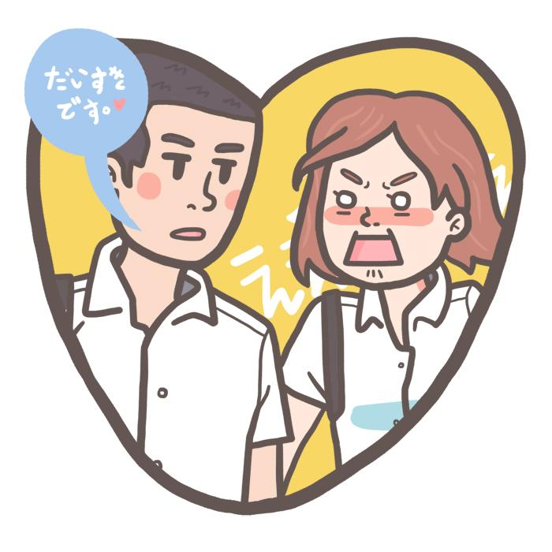
WORKPLACE: STUDENTS
Teachers are much closer to students than in many other countries
SHS vs JHS vs EMS
Touching, clinging, confessions of love
There must be rigid boundaries set and maintained
Outside of school
Living and shopping nearby
Secret part-time working students
Do not go anywhere alone with them
Do not drive your students anywhere
STUDENTS ARE NOT FRIENDS OR POTENTIAL DATES

Slide 10
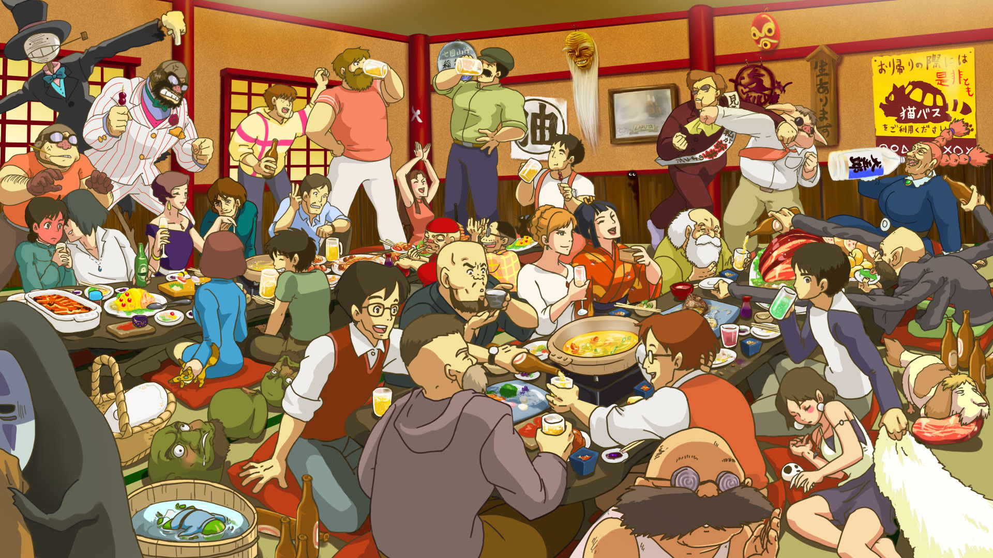
WORKPLACE: TEACHERS – THE GOOD, THE BAD, & THE UGLY
Situations vary greatly; frustration is natural
People are busy, but communication is key
Try to socialize and get to know them
Do not complain to your students or teachers
Talk with your supervisor or an RA
You will be judged differently
It’s a fact… you won’t get along with everyone
Remember that people rotate out every April

Slide 11
WORKPLACE: YOUR SUPERVISOR
Supervisors will come in all shapes and sizes:
Helpful, disdainful, very competent, incompetent, interested in your life, not available, etc.
Try to establish what kind of relationship you can expect early on
If you do not get along with your supervisor:
Try to become more independent from them
Turn to other teachers or friends for advice
Remember your supervisor may change in April
If necessary, try talking to them after school
Talk to older JETs or your PA

Slide 12
RELATIONSHIPS

Slide 13
SOCIALIZING
Japanese friends
Coworkers outside of work
JETs and other foreigners
AJET events
Local events
Act appropriately; students and parents are everywhere
Remember you are a public servant and with that comes certain responsibilities

Slide 14
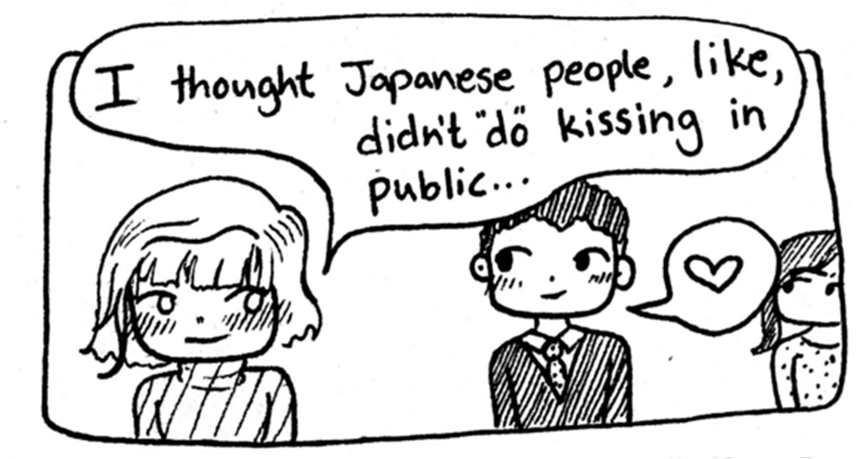
DATING
It’s a normal part of life
Practice safe sex
Dating a Japanese man/woman:
Small towns, big rumors
Cultural differences
Short term vs long term
Foreign girlfriend vs Japanese girlfriend
Communication is key
Dating another JET:
Can heavily affect the JET community
Rumors and secrets spread fast
You will DEFINITELY see this person again
No matter who you date, keep in mind cultural and international barriers, and long distance.

Slide 15
HOMOSEXUALITY
Legally acceptable, protections for gay and transgender people
No same-sex marriage; international not recognized
Some wards in Tokyo have recently recognized same-sex partnerships
Hostility is rare, and understanding or acceptance varies
Rarely spoken about
Not as apparent to Japanese people
NEVER out another person
AJET Group: http://stonewall.ajet.net/

Slide 16
DAILY LIFE

Slide 17
DAILY LIFE: CLOTHING
Yes, you can find clothes in Japan!
H&M
Forever 21
Zara
Gap
Uniqlo
Shimamura
Hard Off
Aeon
You can also order clothes online through Amazon.jp, Rakuten, ASOS, and many other sites and stores.

Slide 18
DAILY LIFE: FOREIGNER ATTENTION
“Gaijin”
Opinions and feelings can be overlooked
Dancing bear
“Gaijin Smash”
Stereotypes and racism
“Jyouzu Chopsticks” comments
Misconceptions and microaggressions
May be accidental or unintentional
Staring and gawking
You attract a lot of attention – mostly positive
Comments about your body
You represent foreigners and ALTs, so set a good example!

Slide 19
DAILY LIFE: HEALTH, MEDS, HYGIENE
Diet - eat regular, balanced meals and have back up meals
Watch the caffeine and alcohol
Exercise – find something to keep you active, especially in winter
Join gym or ask teaches or JETs about sports leagues
Work out at home
Sleep – get well rested
Create a regular sleep schedule
The sun rises very early here
Shower and Toiletries
Japanese toothpaste and deodorant tend to be a little weak
Other stuff you can find here at your local stores
Keep a positive attitude
Remember to set aside time for yourself
Notes:
The Pill - if you want to start taking the Pill while in Japan, do some prior research. The Pill you use in your home country may not be available in Japan. But there may be a Pill available in Japan that has similar/same levels of hormones/ingredients as the one you took in your home country. Also, if you start taking the Pill while in Japan, your Japanese doctor may be ask you to take a gynecological examination.

Slide 20
DAILY LIFE: HEALTH, MEDS, HYGIENE
Condoms
Available at convenience stores, pharmacies, andドンキホーテ
Come in different sizes - diameter is usually on the box
Western condoms - get shipped or buy online
Birth Control Pills
Uncommon; your kind may not be available
Need a prescription
1 or 3 month supply
Morning After Pill
Requires a prescription
Few places have it in Niigata
Clinics are listed at: www.jfpa-clinic.org/search/ ec-list.php?addr1=14
Doctors
Most Japanese doctors are male
Gynecologists: ふじんか (婦人科)

Slide 21
SPECIAL NOTE: STDs
Free confidential AIDS/HIV testing at most clinics
Don’t panic
You will not be dismissed from the JET program
Whether you tell your school or not is your choice
Testing available in Niigata City
Doctor patient confidentiality less strict in Japan
If you get tested in your town, people may find out
The Ueno Clinic is anonymous, next to Niigata Station, quick, and fairly cheap. Testing ranges from 12,000 to 22,000 www.ueno.co.jp | Japan Healthcare Info offers testing by mail: Order your test Pay by bank transfer Receive your kit, test, and mail it back Receive an email with results in English http://japanhealthinfo.com

Slide 22
SEXUAL HARASSMENT

Slide 23
SEXUAL HARASSMENT
It’s called セクハラ (se-ku ha-ra)
It’s not a big problem compared to harassment elsewhere in the world
But it does happen
And it’s important we talk about it

Slide 24
Remember
It is never the victim's fault.
It is always the perpetrator’s fault.

Slide 25
SEXUAL HARASSMENT: GENERAL
Talk to your PA
Don’t be embarrassed
Don’t be afraid
Don’t be ashamed
Think about reporting it
If it goes unreported, there’s a high chance it will happen again and increase in severity
Stay vigilant
Take precautions
Foreigners stand out
Verbal AND physical sexual harassment

Slide 26
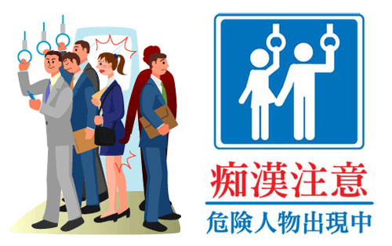
SEXUAL HARASSMENT: OUTSIDE WORK
Example situations:
Public transport
Crowded areas
“Cycle grab”
Parties
Tell your PA
Tell your co-workers:
They will support you and try to help
Your superiors may have local influence
School principals command respect.

Slide 27
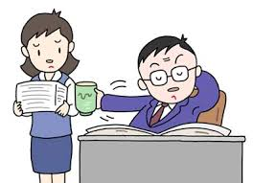
SEXUAL HARASSMENT: COWORKERS
Another teacher:
You can talk to other coworkers and superiors if you are comfortable
You can talk to your PA
Superior:
Talk to colleagues you trust to try and mitigate the problem
Talk to your PA
Power harassment (パワハラ, pa-wa ha-ra)
Cultural differences = reasonable excuse?
The perpetrator may not realize he’s doing it

Slide 28
SEXUAL HARASSMENT: STUDENTS
Usually cases are same-sex, out of curiosity
Curious elementary school students
It’s still not okay
Remember:
Stay calm
Don’t hit the student
Be a mature, sensible teacher
Try not to shout. Explain purposefully
Can get another teacher to speak to them
If it persists, you can talk to PA or supervisor

Slide 29
QUESTIONS?
CONTACT US:
ashleigh.stebbins@gmail.com
amhart9@gmail.com

