Slide 1
JHS/ES Lesson-Planning
Kyle Sponenberg & Tiffany Sheen

Slide 2
4 Steps to Effective Lesson Planning in JHS
Step 1: Find out when you have class
Step 2: Find out what you’ll cover
Step 3: Create the lesson plan
Step 4: Iterate and improve

Slide 3
Step 1: Find out when you have class
Your JTEs WILL be busy. It’s your job to find a time to discuss lessons with them
  Also make sure to make yourself available
Get a schedule well in advance. No one likes being surprised
  Schools make weekly schedules. Having one can be very helpful
Your schedule will change. Sometimes you just have to go with it

Slide 4
Step 2: Find out what you'll cover
Lesson types
  Grammar points
  Reading practice
  Listening practice
  Conversation practice
  Review
Ask if the students have learned the material yet
See if your JTE has suggestions or something specific in mind they want to do

Slide 5
Step 3: Create the Lesson Plan
Things to consider when planning:
Class length
  45 vs 50 min
Activity time/lesson schedule
Warm up activities
Transitions
Directions
Materials
Activities
JTE’s role
What period is the class
Class attitude
Class/activity goals

Slide 6
Step 4: Iterate and Improve
Reflect on your lessons once you've finished
  What worked and what didn't?
  How did the class react?
  What does your JTE think about it?
Make concrete changes- even if they're small
Keep notes on all of your classes to help plan in the future.
Iterate on lesson planning itself.
Use your self-introduction lesson as a testing ground.

Slide 7
Lesson Plan Skeleton
Greetings
Warm-up
Main Activity 1
Main Activity 2 (if necessary)
Closing
Notes:
Review can be fitted into the lesson at any stage, either as a warm-up, or right before an activity or game

Slide 8
Greetings
Hello/Good morning/Good afternoon!
How are you? I’m ~
What day is today? It’s ~
How is the weather?
Review previously taught grammar points
Notes:
There’s a common phenomenon when you first try to implement this. For example, you ask the class “How are you?” and you get a very confident “How are you?” reiterated back to you. So you show them that it’s a question-answer situation. How are you? I’m fine, etc. Same with askign the day of the week, and the weather. In the beginning when you’re just establishing a routine, especially with 5th graders, it’s very helpful to implement gestures and pair your greetings with flashcards. Eg. I’ll ask “What day is today?” and hold up a flashcard that says Wednesday, and the Japanese equivalent, suiyoubi.
This is also a great time to throw in questions you taught them last lesson. For example, pick a student number/name and ask them “Do you like oranges?” Pick a couple more students. And by this point you’ve shifted into a sort of warm-up.

Slide 9
Warm-up
Review
Short activity
Depending on the class mood that particular day, start with something either
  active
  passive
Notes:
Where you’re reviewing things you’ve taught or just things you taught last lesson, OR doing a small game
These two categories apply to main activities, not just warm-ups. So what do I mean by active…

Slide 10
Active
Target: Dull, sleepy, sluggish-looking class
Examples
  Moving around
  Interview
  Games
Notes:
Activities that require them to move around the class, get their limbs moving and move their muscles. Games that increases the energy of the class and are typically ''rowdier''. For example, pac-man, mario karts, criss-cross, pictionary relay, etc. Group competition or activity can also be applicable, but keep in mind some classes will respond differently and a sluggish-looking class might remain just as sluggish through a supposedly energizing activity, while another sluggish-looking class might brighten up from the same activity
On the other hand, sometimes they love the warm-up game so much, that you end up doing that game for the whole lesson

Slide 11
Passive
Target: overactive, rowdy class
Examples
  listening (in textbook)
  drawing
  writing (practice writing the alphabet)
  desk-work
Notes:
I give my students tracing paper and we trace through A-Z slowly, doing a few alphabets at a time.
You can even do this at the end. I use this at the end so while they're writing, I have ample time to give out stickers to students who raised their hand and presented in class (if you have good memory. If you have bad memory, you can consider giving them out as you ask them questions. I just prefer doing it at the end so it doesn't take up time during an activity) and give out stamps in their passports

Slide 12
Main Activity
Lesson focus
Usually involves key grammar point or vocabulary
1-2 main activities per lesson depending on class size, level, and speed

Slide 13



Students’ comfort level
Students use English easily on some levels than others
Group
Pair
Individual
Notes:
Everyone is comfortable on different levels, sometimes all, sometimes only one.
Most students are most comfortable at group-work, where attention is spread across multiple people. Shyer students might prefer this setting the most. If you are doing a game that involves groups competing against one another, and each person in the group rotates to give an answer, then it exerts more pressure than simple group games and kind of becomes individual performance.
Pair work is the middle-ground. It makes students at ease, without letting them get too excited and loud.
As for individual, there’ll always be those coupel of kids who raise their hands everytime you ask a question. More often than not though, you can get a very disquieting total silence from the class. Culturally they have been imbibed with the mindset that it’s better to keep quiet than to make a mistake. So many Japanese students are afraid of making mistakes - this is less evident but still observable at the ES level. A lot of students just don't say anything because they are bad at English, don't want to make an effort, or are simply daunted by the whole ordeal. And this is where you use encouragements, rewards like stickers to lure them out, and show them that it’s okay even if the answer is wrong. You just want them to try.
Talk to them in simple English about their interests (you can tell from their T-shirt, pencilcase, bag or drawings) to at least make them feel comfortable interacting with you and take their mind off focusing on English class as a scary, troublesome thing
Sometimes you might have to give a little more help to students that are struggling or nervous presenting/using English alone ie. presenting their work and speaking in front of the whole class. Give lots of encouragement. When correcting their mistakes, do it in a positive manner and reaffirm their good effort at the same time.

Slide 14
Learning Stages
Vocabulary
Simple grammar
Question- Answer
Notes:
At younger grades 1-3, you might stop at introducing simple grammar or question-answer form
Some classes might need to spend more time on one stage than another. There's a trend for students here to absorb and remember a lot of words - you'll be surprised at their vocabular bank. However that amazing absorption weakens when it becomes a longer sentence, and question-answer form. This is because they have to remember most of what they are taught BY THEIR EARS. Reading and writing the alphabets don't happen until junior high school. With no visual to associate sounds with and rely on, it becomes a memory test. And the more they practice, they more they are likely to remember it. For example, I say ''See you next time'' everytime I end a class. They pick it up right away because I say it so many times. This is true for learning any languages - you pick up the things you hear repeatedly. Similarly, the more you go over grammar points, the more comfortable they get

Slide 15
Example: Shapes
Vocabulary
  Start with easy ones:
  Slightly difficult:
  Very difficult: oval, rectangle
Reinforcement
  Card Collection Game
  Individual Testing
Notes:
Shapes that have the same name in Japanese will be easy.
Card collection game:
-janken
-winner shows his/her hand
-loser says ''___shape___, please''
-winner gives loser the card
-goal is to have no cards
I’ve personally tried this.
Of course we don't go around in our daily conversation asking for shapes. However this grammar point, ___ please, still adheres to when we ask for things. And at this stage the purpose is to just familiarize them with shape names. This game trains them to recognize shapes visually and then name them, and relies on the visual-vocal associatio, which is the ultimate purpose of learning how to say a shape in English. You want them to be able to name something they see
Keep in mind: students who cheat through this activity without speaking a word of English gets penalty
penalty
-have them police each other; if the loser doesn't say English and just picks a card, give them two cards
-walk around and help them out
-get your HRT in on this one to tell the kids to use English
^ a common problem in any interview activity
Individual testing
-a friend’s idea
-suitable for classes that glaze over and doesn’t want to repeat after you
-essentialyl make them police each other

Slide 16


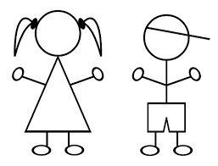

Example: Shapes
More/review
  Speed-talking
  Group drawing game
Circle!
Notes:
Personally tried speed-talking. Time it.
(popular throughout all grades
1 individual comes up to represent group
they rotate drawing on whiteboard within a group

Slide 17
Example: Shapes
I like ~
Do you like ~?
Yes, I do.
No, I don’t.
What ~ do you like?
Notes:
At younger grades 1-3, you might stop at introducing simple grammar or question-answer form
Some classes might need to spend more time on one stage than another. There's a trend for students here to absorb and remember a lot of words - you'll be surprised at their vocabular bank. However that amazing absorption weakens when it becomes a longer sentence, and question-answer form. This is because they have to remember most of what they are taught BY THEIR EARS. Reading and writing the alphabets don't happen until junior high school. With no visual to associate sounds with and rely on, it becomes a memory test. And the more they practice, they more they are likely to remember it. For example, I say ''See you next time'' everytime I end a class. They pick it up right away because I say it so many times. This is true for learning any languages - you pick up the things you hear repeatedly. Similarly, the more you go over grammar points, the more comfortable they get

Slide 18
Example: Shapes
Ultimate Practice
  Design and present your own T-shirt!
Bonus
  Throw color into the mix
Notes:
Applicable to younger grades as well
Practice using
bingo
card collection game (this time saying __colored__ + __shape__)
drawing game on blackboard OR
broken telephone
you tell the first kid in a row the type of shape
they pass it down
the last kid has to come up and draw it on the board
rotate the kids so everyone gets to both draw and listen
excellent for practicing listening comprehension, speaking, and applying

Slide 19
Wrap-up
Leave 5 minutes for students to write review sheets
Give out stickers and stamps
Goodbye

Slide 20
Classroom English
Consistent
Short, memorable phrases
With gesture or Japanese translation
Examples:
  Stand up, sit down
  Look up, listen up
  Open your textbook
  Finish, collect from the back
Notes:
(drop gesture & translation over time, they would've gotten familiar enough with it to know what it means)

Slide 21
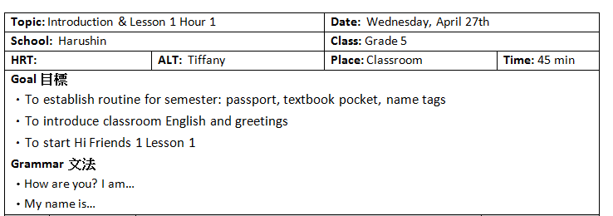
Lesson Plan Example
Notes:
If you have multiple schools, I highly suggest making an excel doc keeping track of each class progress and what to do next class
Topic = Which lesson of the book are you doing? What’s the theme? Helps you keep track of how many hours of a particular lesson you have done
Goal = What would you like to get done in this lesson? For me, I wanted to give the students some time to decorate their passport booklet and, if time allowed, make nametags. I was also aiming to introduce some basic, key English phrases that will be repeated and used to maintain order and manage activities during English lessons. Moreover, I wanted to start the Hi Friends curriculum
Grammar = And for that day’s lesson I’ve narrowed the main grammar point down to these three phrases
This section is like brainstorming. Once you have it written down, you can better build activities and games around the main grammar point of the day, and have an idea what you can omit and what you should prioritize if time is running short.
You will be getting used to the pace and level of each of your classes. So you may find yourself running short on time or with a lot of extra time. Knowing what you want to accomplish (goals) and the students to take home that day helps you decide how to improvise with time. And later we’ll talk about filler games, which are games you could throw in as a buffer in between activites or during extra time.

Slide 22
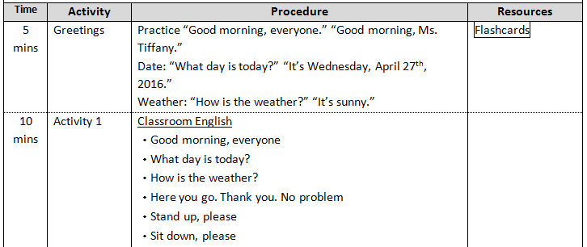
Lesson Plan Example
Notes:
Here, the nitchoku will start each class with a greeting. You can utilize that and teach them how to do it in English. Might be difficult and slow at first but they get the hang of it really quickly.
Then here you see I’ve jumped to one of the main activities of the day, which is to teach them some classroom English
Timing is rough. Something might run longer or shorter than you expected. And you get better as estimating overtime.

Slide 23
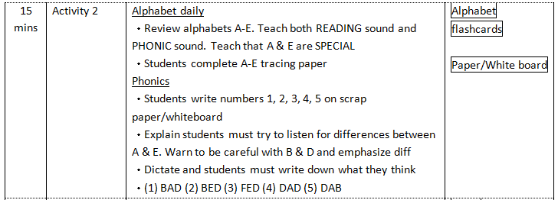
Lesson Plan Example

Slide 24
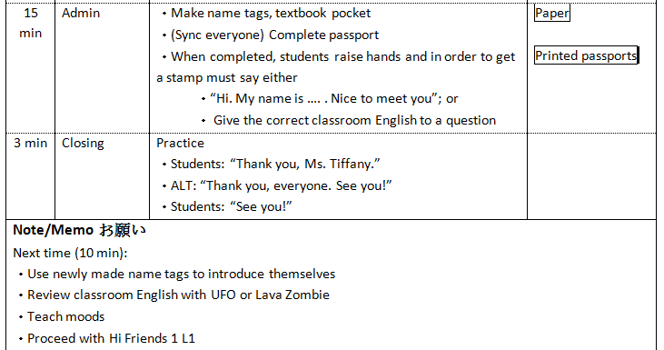
Lesson Plan Example

Slide 25
Filler games
Keyword game
Bingo
Broken telephone
Hangman

Slide 26
Tips
Familiarize yourself with textbook
Run your ideas by your JTE
Always have some filler games/activities
Over-budget your time
Tailor your lessons to each class
Run the class with the same attitude you expect from them
Change an activity for next time if it didn’t work effectively
Notes:
-dun get unnerved by their reactions/words
RESOURCES- ENGLIPEDIA

Slide 27
Team teaching

Slide 28
Challenges of Team-Teaching
Different teaching styles & expectations
Level of communication (during and outside class)
Determining responsibilities
Language barrier
  language abiliy or lesson plan do not always match up to their enthusiasm; vice versa

Slide 29
Teaching Styles & Expectations
Communicative
I want to relax~
I want in on the action!
Here's the lesson plan! See ya!

Slide 30
Communciation
Keep it open
  take the initivative if they don't
  Keep it two-way
  Actively and politely make suggestions
  Ask for their opinion
  Clarify
  If you aren’t sure about something, ask!
Notes:
On the other hand, ask for their opinon. (is this going to run well with that particular class? are there any foreseeable problems?)
More advanced/as time goes on
spot their hesitation and ask if they have a different suggestion about an activity/plan

Slide 31
I want you to…
Do everything!
Give me something to do too!
Do it exactly like this!

Slide 32
I want you to do everything!
Everything = deciding lesson focus
Everything ≠ running everything yourself
Show your appreciation
Polite bonus:
  Inform them in advance what you’d like them to do
  They can be better prepared
Notes:
If this is the case, AIM FOR the middle ground, “I want to do something too!”
Most teachers who are helpful will walk around and monitor. Sometimes if you don’t say anything they feel like you don’t even need them to do that, and they stop doing it and start standing at the back of the classroom. To prevent this, I tell my HRTs how much I appreciate them doing that and sometimes even get them to help me pass out stickers or stamps
Tell them what you're doing in advance and where you'd like their help, so they know how to help you and can be prepared* draw from my own experience

Slide 33
Fundamental JTE/HRT roles
  Demonstrating activities with you
Involve them in class micromanagement:
  Walk around & monitor
  Pick students to answer
  Give instructions
  Sometimes you need them to translate

Slide 34
Do it exactly like this!
Good guideline to start with
CAUTION: do NOT ignore lesson plans
Solution
  Overt
  Passive
Notes:
You can build on it
This is kind of stepping on their toes. We are GUESTS in their classroom.They might disengage, and you NEED their support (they are the HRT and essential for discipline and controlling the class and is a respected figure in front of their kids. If they become impassive about/during your lessons it is only to your detriment)

Slide 35
Overt method
Be open-minded
Tactfully vocalize your suggestions and opinions
☺ treats both equally
☺ open communication
☹ time and language barriers

Slide 36
Passive method
Run their lesson plan
Insert your own activities
Gradually phase out their plans
☺ saves time and language challenges
☹ disengagement and withdrawal of support

Slide 37
Your JTE/HRT will know better than you…
Their students’ personality
Their students’ learning style
Student names
Whether your students are having a hard or easy time with the lesson
MAKE USE OF THESE!

Slide 38
CAUTION AND PRO-TIPS
Run the class like you and your JTE/HRT are a team trying to sell something
Make use of JTE/HRT's fortes
If JTE/HRT does nothing to discipline the class, talk to them
Do NOT try to discipline/reprimand students on your own – It’s NOT your job
Most of the problems you have with HRT/JTEs can be fixed by talking to them
Notes:
dont contradict/challenge them in class (eg. when they spell something wrong)
You need that to run a lesson successfully

Slide 39
Advice from JETs
“Don’t wait for your JTEs to come to you. Be proactive and engage first” – Janice Laureano, 5th yr, PA
“Be flexible and compromise” – Jess Mancoo, 3rd yr ES/JHS
“Make sure there’s a flow, and that both you and your JTE know what you’ll be doing” – Ben Kohanski, 2nd yr ES/JHS
“Keep activities simple and easy to explain” – Will Norton, 2nd yr ES/JHS
“Start from where you’re comfortable and expand your comfort zone” – Daniel Taylor, 2nd yr HS
“If you notice a problem, roll with it and work out a solution for the next time” – Iris Cheung, 2nd yr ES/JHS
“Fill a lesson with no more than 3 activities” – Eric Kortschak, 3rd yr ES/JHS
“Adapt to your JTE’s teaching styles and methods. Ask the When, Where, How, What, Who” – Matthew Headland, 5th yr ES/JHS

