Slide 1
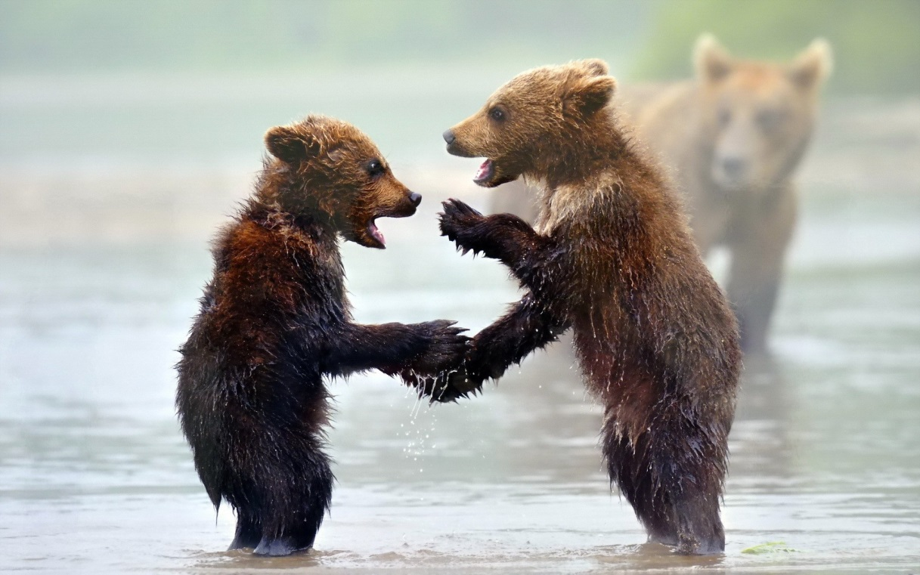
Self introduction in Elementary School

Slide 2
Plan
Audience
Content
Length / Material
Game types
Example
Question time!

Slide 3
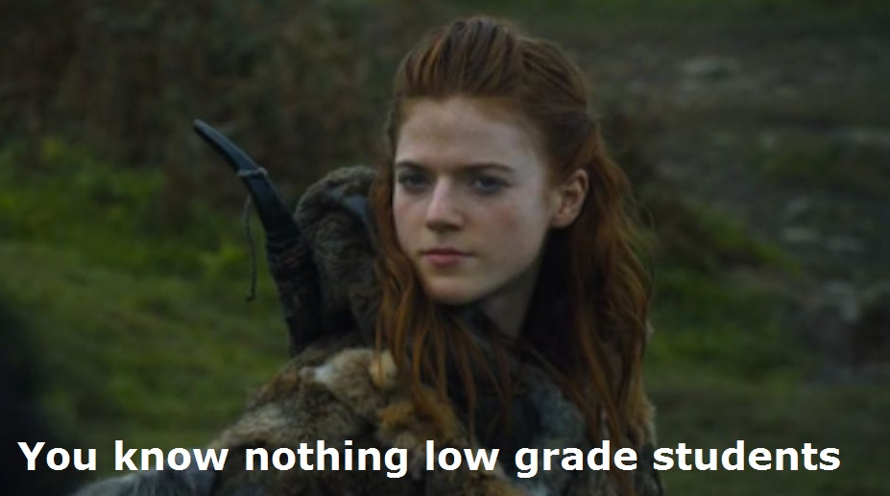
How old are the kids?
1st and 2nd grade = 6-7 years old (teigakunen 低学年）
super motivated
easily confused, cry easily
weak English abilities, no world knowledge!
3rd and 4th grade = 8-9 years old (chugakunen 中学年)
motivated
know a bunch of activities
basic English abilities, basic world knowledge
5th and 6th grade = 10-11 years old (kogakunen 高学年）
low motivation
quickly ashamed
basic grammar knowledge, average world knowledge

Slide 4
Contents
For all grades:
colors (favorite color/ colors of your flag, of you pets)
animals (your pets!)
fruits (favorite fruit)
numbers 1- 10 (how many pets you have)
vegetables (favorite vegetable)
country flags (your country‘s flag)
food (from your country/ favorite food)
sports (that you play/ like/ watch)

Slide 5
Contents
From middle grade:
family (sisters/ brothers)
weather ( in your country)
transportation (how you come to school?)
days of the week (what day you come to that school)
month (your birthday)
For 5-6th grade only:
alphabet (how to spell your name)
can/ can‘t
anything that is in the „Hi friends!“ textbook

Slide 6
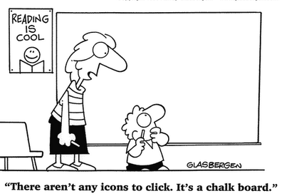
Length/ material/classroom arrangement
Check with your ES teacher:
how long they want you to speak (10 minutes at the beginning/ half of the class/ all class)
what material they have (computer-projector/ smartboard / TV /nothing => laminate pictures+chalk)
If the kids will be seating at their desk or on the floor.

Slide 7
Game types
Maru / batsu

Slide 8
I come from Sweden.

Slide 10
Game types
Maru / batsu
Multiple choice answer

Slide 11
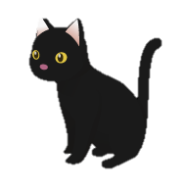
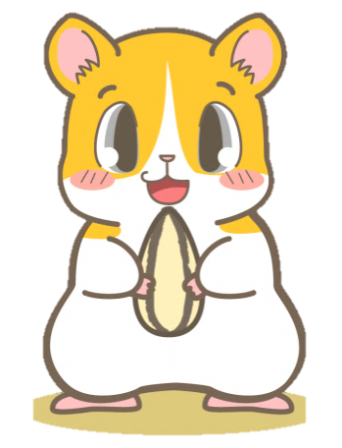
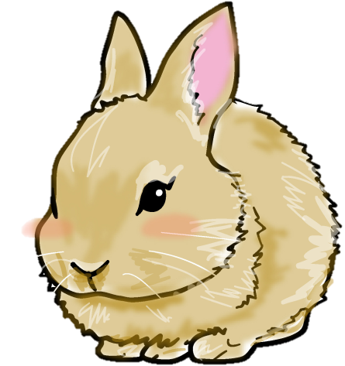
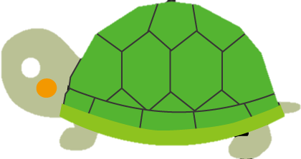
A) B) C)
Notes:
I have pets. Can you guess which pets I have? A) is dogs, cats and turtles. B) is ? Do you know? Cats, Rabbits and birds. What about C? A hamster and a fish. Which do you think I have??
Answer is A! So I have..

Slide 13
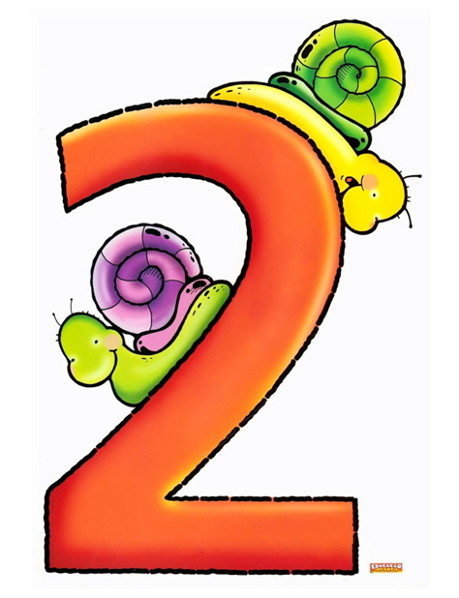
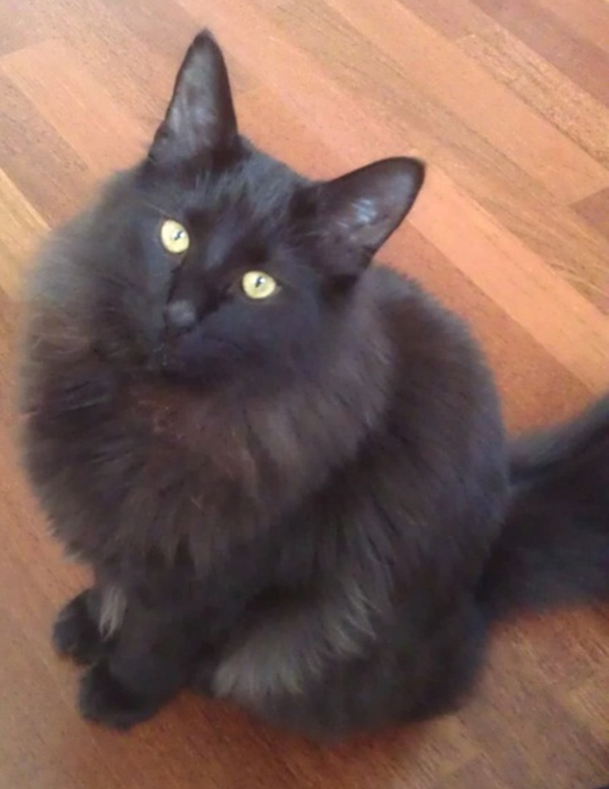
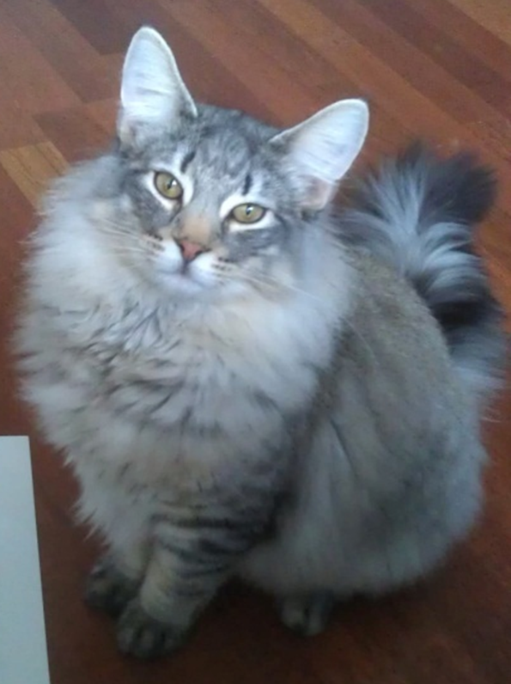
Notes:
2 cats. I have a black cat and I have a grey cat. They are brothers.

Slide 14
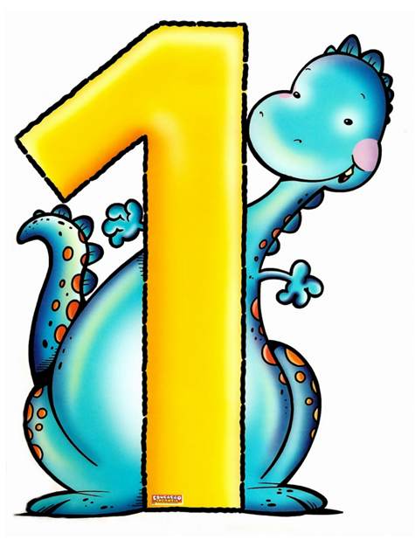
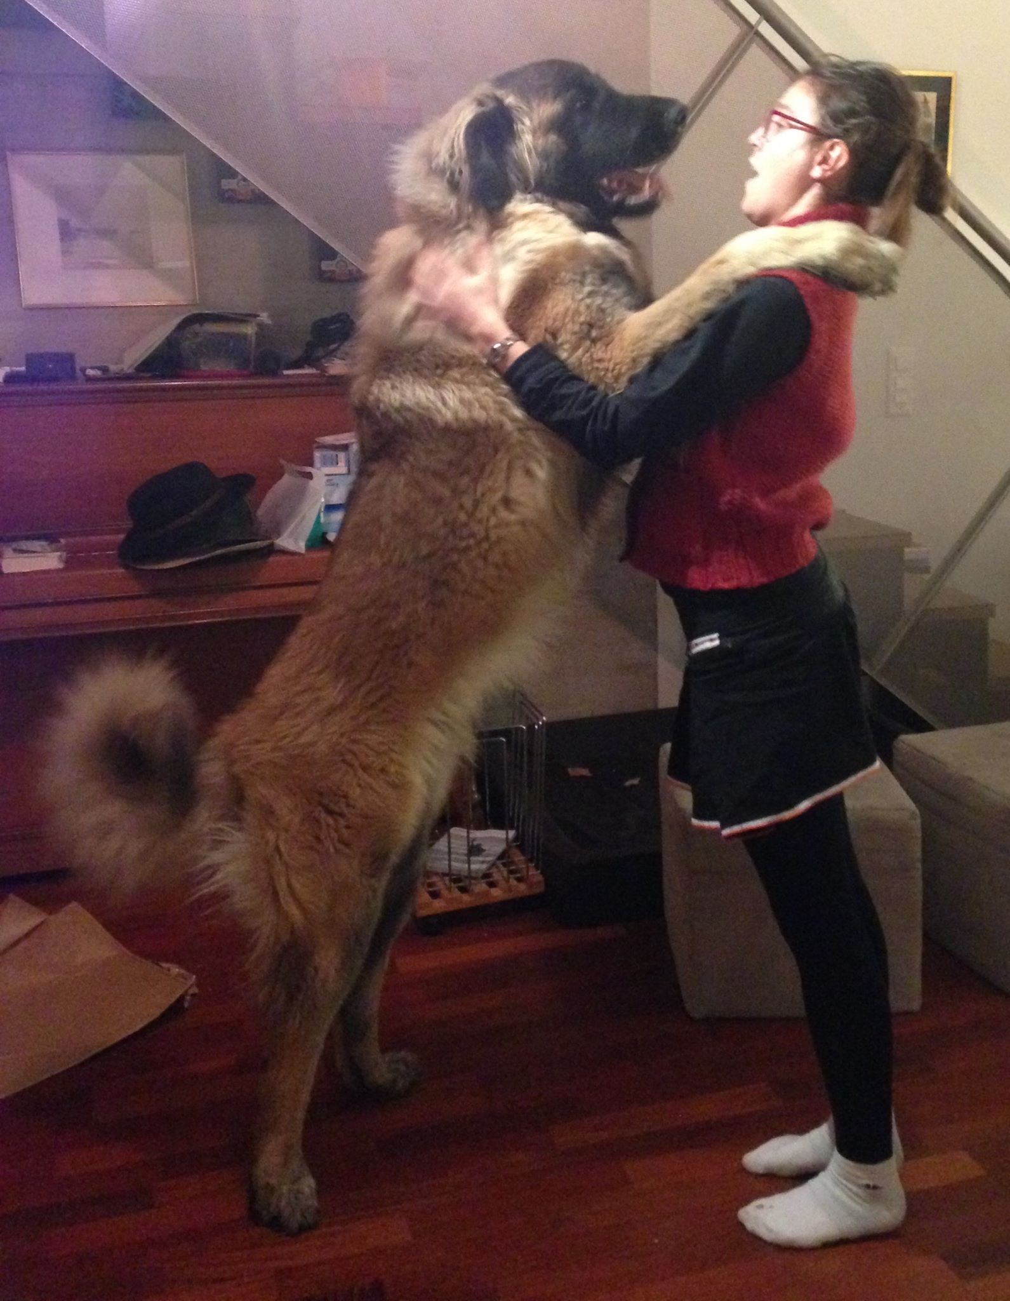
Notes:
I also have one dog! His name is Hachiko. He is very big. It is a brown dog.

Slide 15
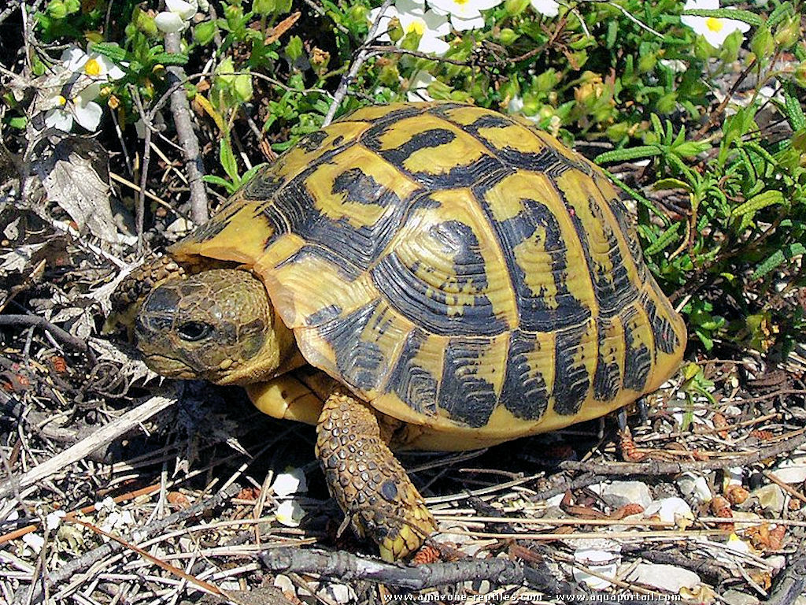
Natacha
Notes:
And I have one turtle. It is a small turtle.

Slide 16
Game types
Maru / batsu
Multiple choice answer
2 truths/ 1 lie

Slide 17
Which one is the lie (uso)?
I have three sisters.
I don‘t like watermelons.
I speak six languages.

Slide 18
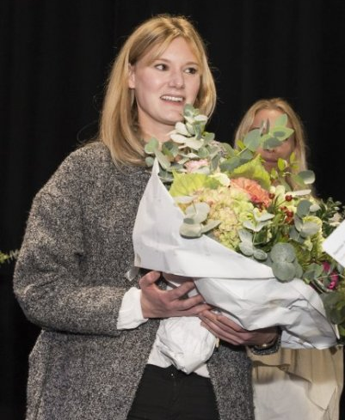
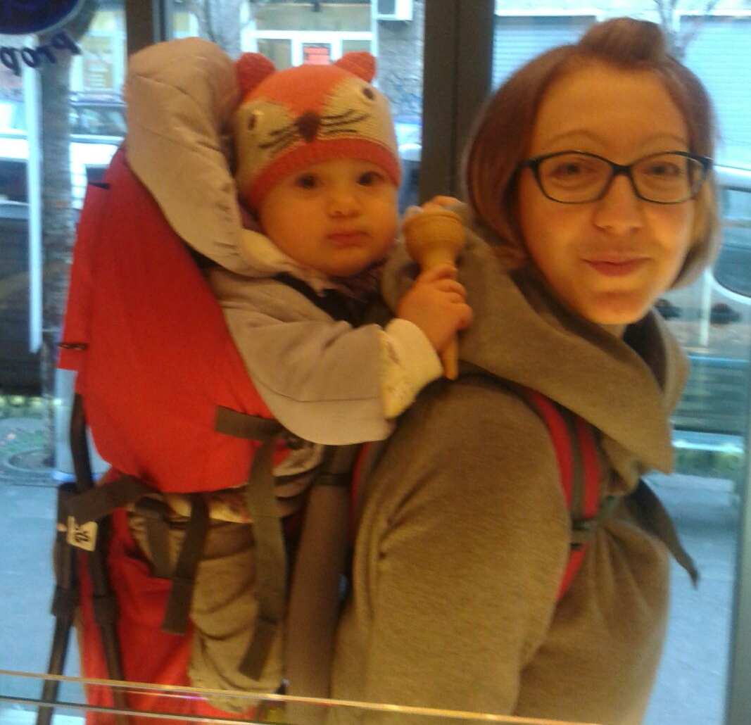
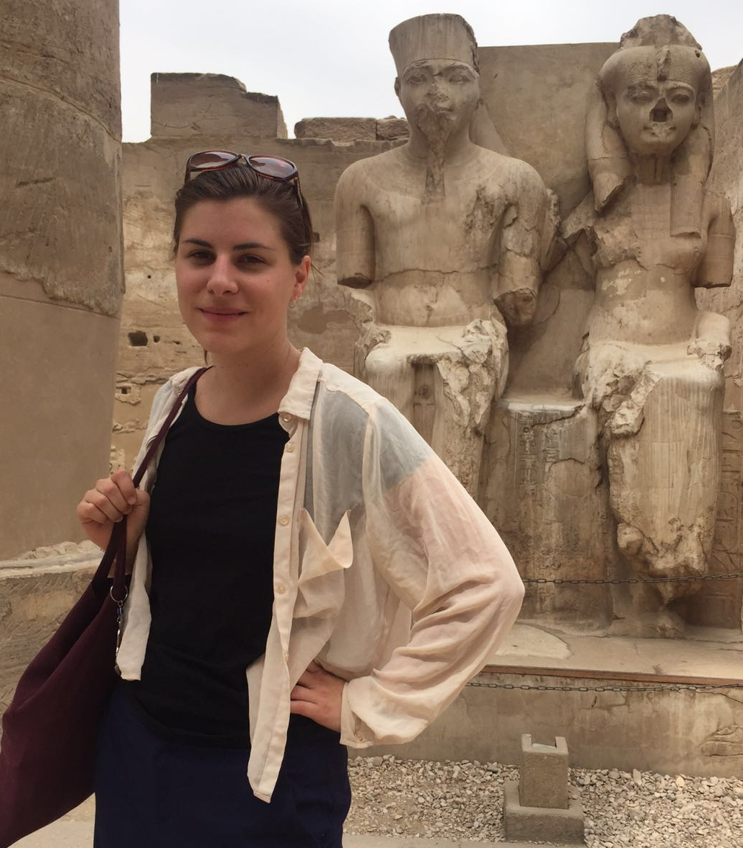
Notes:
This is Sophie, she lives in Switzerland, she is a movie director. She makes movies!

Slide 19
Which one is the lie (uso)?
I have three sisters.
I don‘t like watermelons.
I speak six languages.

Slide 20
I love watermelons!

Slide 21
Which one is the lie (uso)?
I have three sisters.
I don‘t like watermelons.
I speak six languages.

Slide 22
French
German
English
Japanese
Korean
Japanese sign language

Slide 23
Game types
Maru / batsu
Multiple choice answer
2 truths/ 1 lie
Others

Slide 24
Please remember:
the goals of the lesson are:
learn about you
practice their English skills (listening AND speaking)
ask them questions too.
try to speak mostly in English.
if you have too much time left, sing a song with them (7 steps/ head, shoulders, knies & toes)

Slide 25
Example
Version A: ES class simulation, questions at the end.
Version B: Quick explanation of the Self Intro, time to practice for everyone.

